Slide 1
Introduction to Data Science
Section 4 - Principal Component Analysis
Some material is based on
Stack exchange: http://tinyurl.com/586frkz9
Wikipedia: https://en.wikipedia.org/wiki/Vector_projection
Bulitin: http://tinyurl.com/47yswh3e (but don't follow their standardization!! It is wrong!)

Slide 2
Goal of PCA
Find the "orientation" of the data
How? Compute principal components
Reduce dimensionality of data
How? Project data onto principal components

Slide 3
PCA Step 0: Data and dimensions
Data X: number of dimensions by number of samples
Typically, but not always, X is long and fat.
number of dimensions << number of samples.
Note: manual/math implementation (above) different from sklearn (need to transpose with .reshape(-1,1))

Slide 4
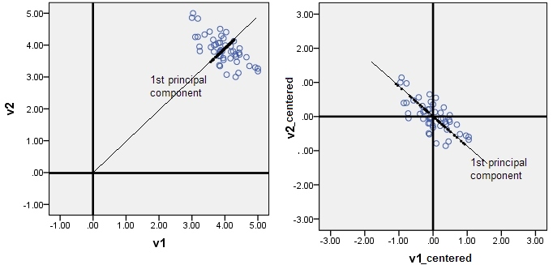
PCA STEP 1: Center data
Center data to origin.
How? Compute mean on each dimension, then subtract from data.
Otherwise...

Slide 5
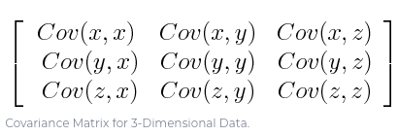
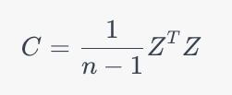
PCA STEP 2: Covariance Matrix
Let Z be centered data
Each entry C[i,j] is the covariance between dimension i and dimension j

Slide 6
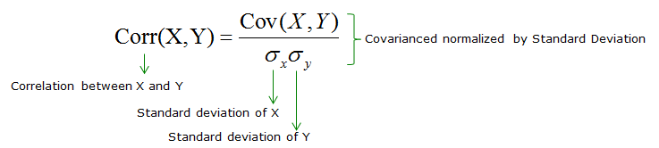
….. Aside: Correlation Matrix
Correlation is just a "standardized" version of covariance.
Bounded: -1 ≤ Corr(X,Y) ≤ 1
https://www.sharetechnote.com/html/Handbook_EngMath_CovarianceMatrix.html

Slide 7
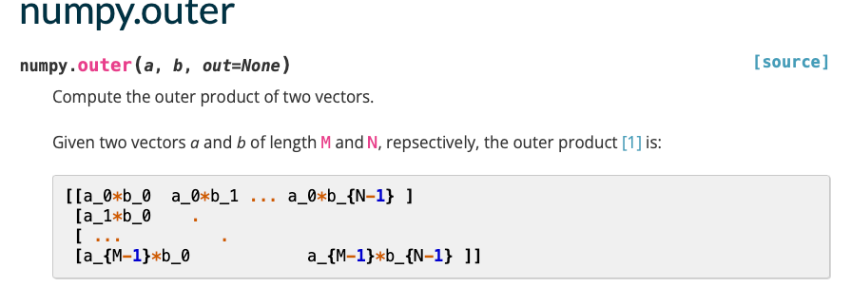
….. Aside: Correlation Matrix
Correlation = Covariance / np.outer(X,Y)
Division is entry-wise, thus consistent with prev slide

Slide 8
PCA STEP 3: Compute eigen-stuff
Singular value decomposition UDW = C
U: columns are the eigenvectors
Exactly the principal components. Wohoo!
Orthogonal (think of it as rotation of data)
D: corresponding eigenvalues
Always ≥ 0!
W: this is just U^{T} (usually not the case, but why is covariance matrix special?)
Those are the basics! After eigen-stuff, there are many things you can do.

Slide 9
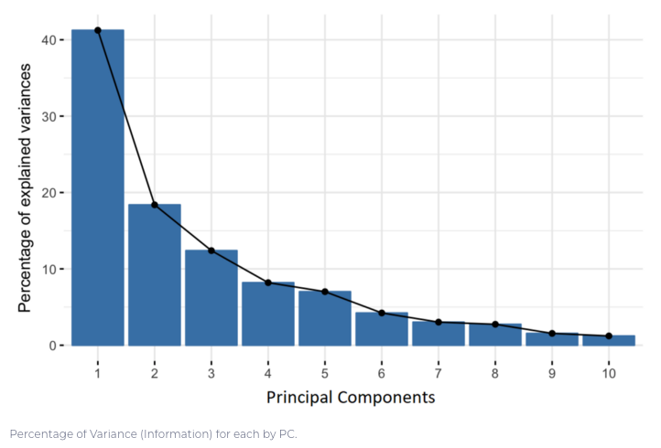
Percentage of variance of data

Slide 10
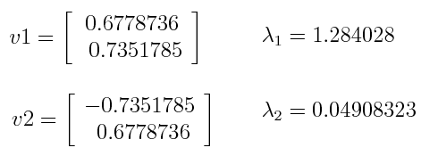
Percentage of variance of data
Compute the percentage of variance (information) accounted for by each component
How? Divide each eigenvalue by the sum of eigenvalues.
That’s why: "percentage of variance"
Example: PC1 and PC2 carry 96% and 4% of the variance of the data.

Slide 11
B. Dimensionality reduction
What if data is tall and skinny?
number of dimensions >> number of samples
Then we may want to reduce dimensionality of data. Either:
Data is actually low-dimensional or
"Most important information about data" can be captured by low-dimensional representation

Slide 12
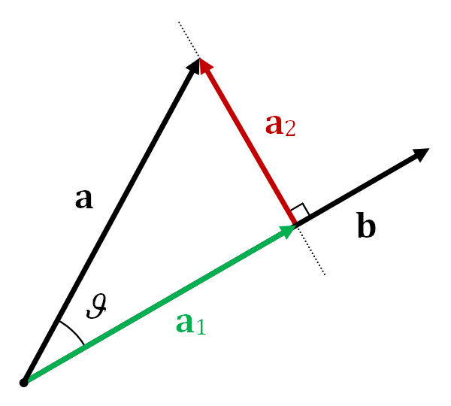
B. Dimensionality reduction
How? Project data onto principal components/eigenvectors
Recall: a•b = a^{T}b (= a₁ in fig) is "magnitude of a in b"
Magnitude of data in
First PC : U₁^{T} X
First k PC : [U₁ … U_{k}]^{T} X
"change of basis" to PCs
Project data onto
First PC : U₁U₁^{T}X
First k PC : [U₁ … U_{k}][U₁ … U_{k}]^{T} X
"projection"

